Slide 1
Proposal Presentation
Matting based on Bayesian algorithm
Lingyu Gong, Changhong Li, Qiwen Tan
E3 School
Date 15/02/2024

Slide 2
Content
Group Introduction(Tan )
Mathematical Algorithm(Tan )
Function Blocks(Gong)
Testing Plan(Gong)
Flow of Implementation(Changhong)
Milestones and timeline(Changhong)

Slide 3
Group Introduction
The development of Network-on-Chip
Rising Mobile App Demand: Increasing number of mobile applications drives the need for enhanced integration and performance.
Importance of Communication Architectures: These architectures are key to system area, performance, and energy efficiency.
Challenges with Traditional Global Connectivity:
Synchronization Errors: On-chip timing issues.
Unpredictable Delays: Inconsistent communication times.
High Power Consumption: Increased energy use due to inefficiencies.

Slide 4
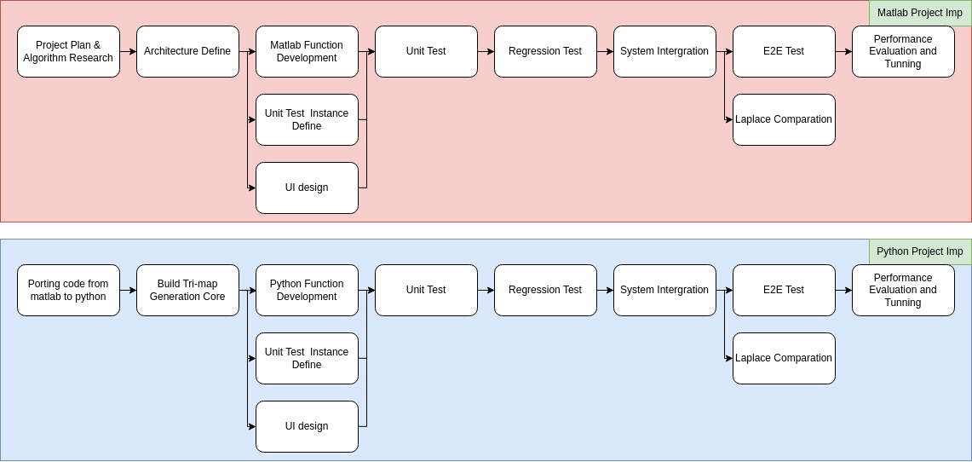
Flow of Implementation
Implementation of whole project

Slide 5


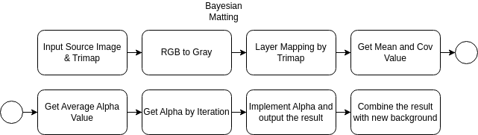


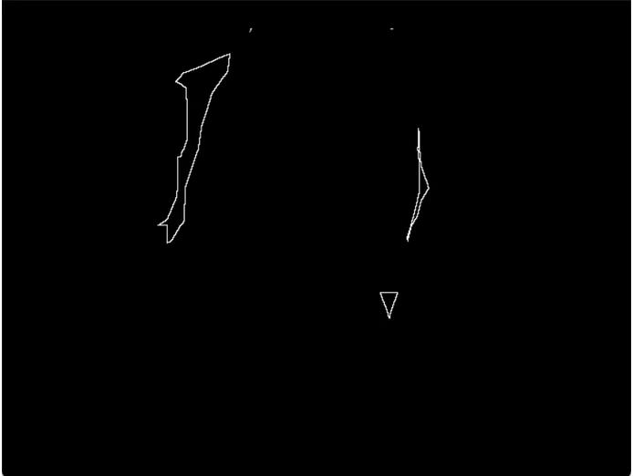

Flow of Implementation
Core Algorithm Implementation

Slide 6
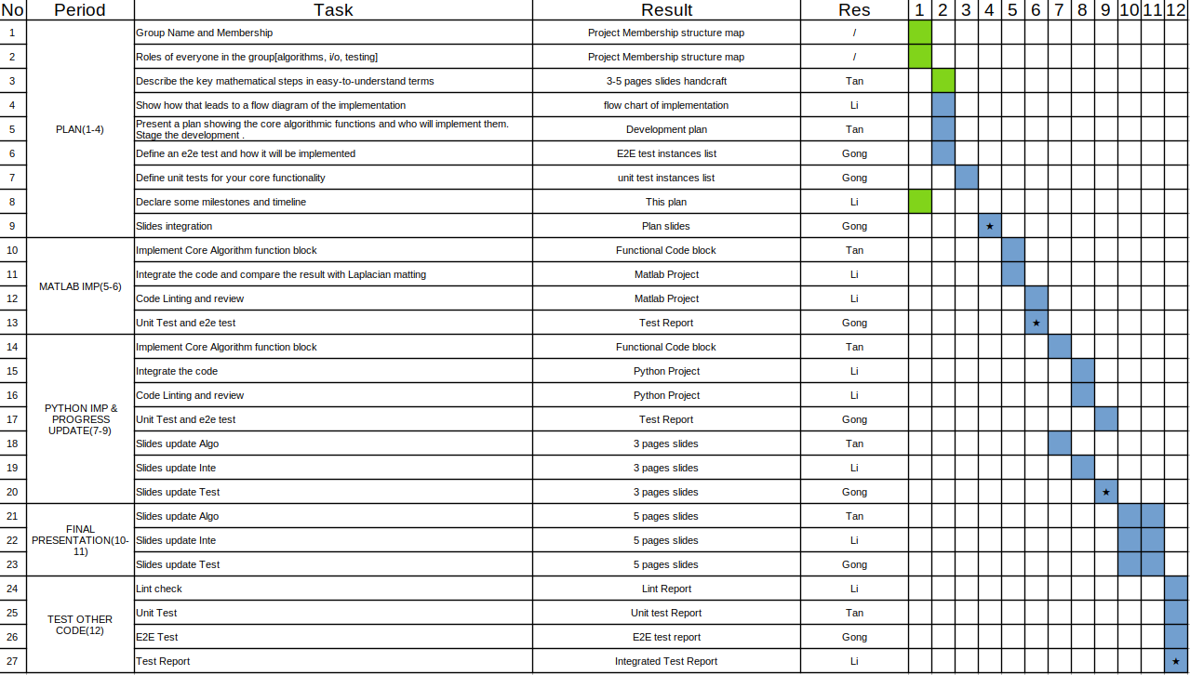
Milestones and timeline

Slide 7
Thank You

